Slide 1
Just cool?
A beaker of hot water is put into a bowl of cold water.
The hot water is kept in the beaker and does not mix with the cold water.
Room
21ºC
Hot water
85ºC
Cold water
21ºC

Slide 2
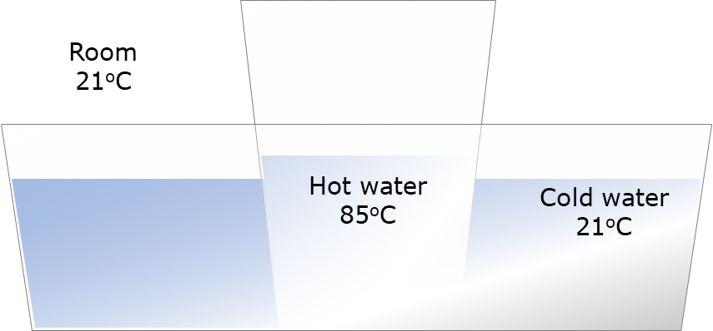
Just cool?
What do you think will happen?
I am sure this is right
I think this is right
I think this is wrong
I am sure this is wrong
A
The temperature of the hot water goes down
B
The temperature of the cold water goes up
C
After a long time the temperature of all the water is at the same temperature as the room
D
The temperature of the room goes up a tiny bit

